Slide 1
Predicting Housing Price in California
Allen Yang

Slide 2
Introduction
Being able to predict housing price is very important to real estate investors
With the information, investors can decide whether there is a buying or selling opportunity.
This project builds regression models to predict housing price with given metrics.

Slide 3
Data collection
The dataset is California Census Data published by US Census Bureau
Contains 10 types of metrics for each district in California.
A district has a population of 600 to 3,000 people
10 metrics are longitude, latitude, housing median age, total rooms, total bedrooms, population, households, median income, ocean proximity, and median house value.
20,640 rows in dataset. 207 rows with missing values are dropped.
Outliers 3 times standard deviation away from the mean are dropped.

Slide 4
Descriptive Analysis
The dataset contains 20,640 records
Descriptive statistics
 | longitude | latitude | housing_median_age | total_rooms | total_bedrooms | population | households | median_income (in $10,000) | median_house_value
count | 20,640 | 20,640 | 20,640 | 20,640 | 20,640 | 20,640 | 20,640 | 20,640 | 20,640
mean | -119.56 | 35.63 | 28 | 2,635 | 537 | 1,425 | 499 | 3.87 | 206,855
std dev | 2.00 | 2.13 | 12 | 2,181 | 421 | 1,132 | 382 | 1.89 | 115,395
min | -124.35 | 32.54 | 1 | 2 | 1 | 3 | 1 | 0.49 | 14,999
max | -114.31 | 41.95 | 52 | 39,320 | 6,445 | 35,682 | 6,082 | 15 | 500,001

Slide 5
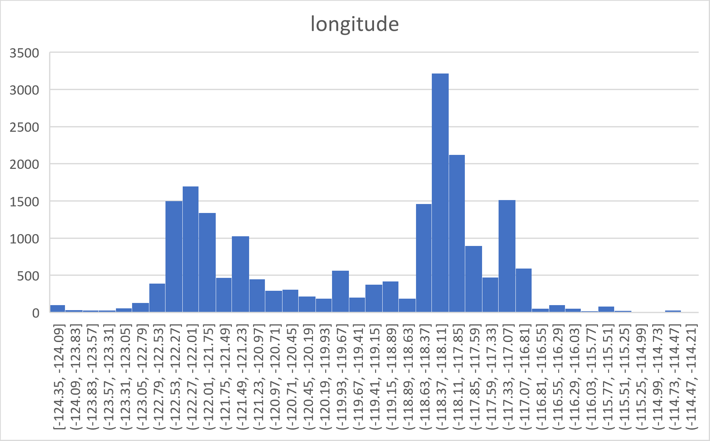
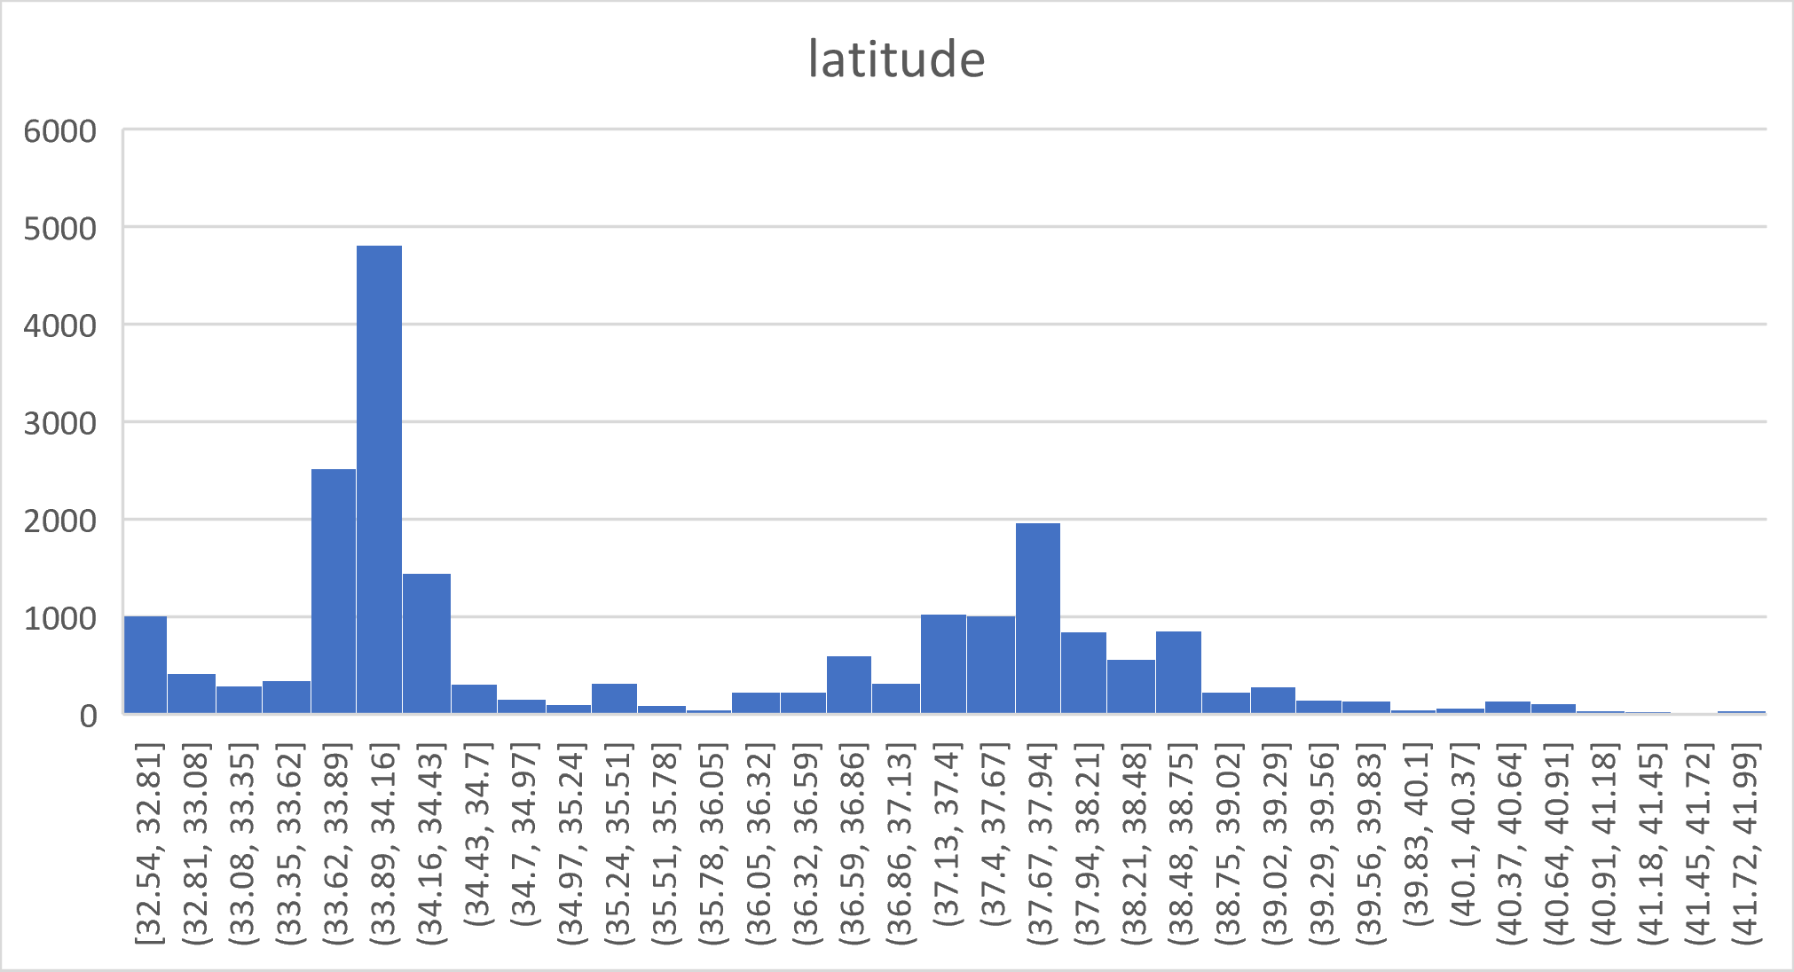
Descriptive Analysis
The distributions are bimodal

Slide 6
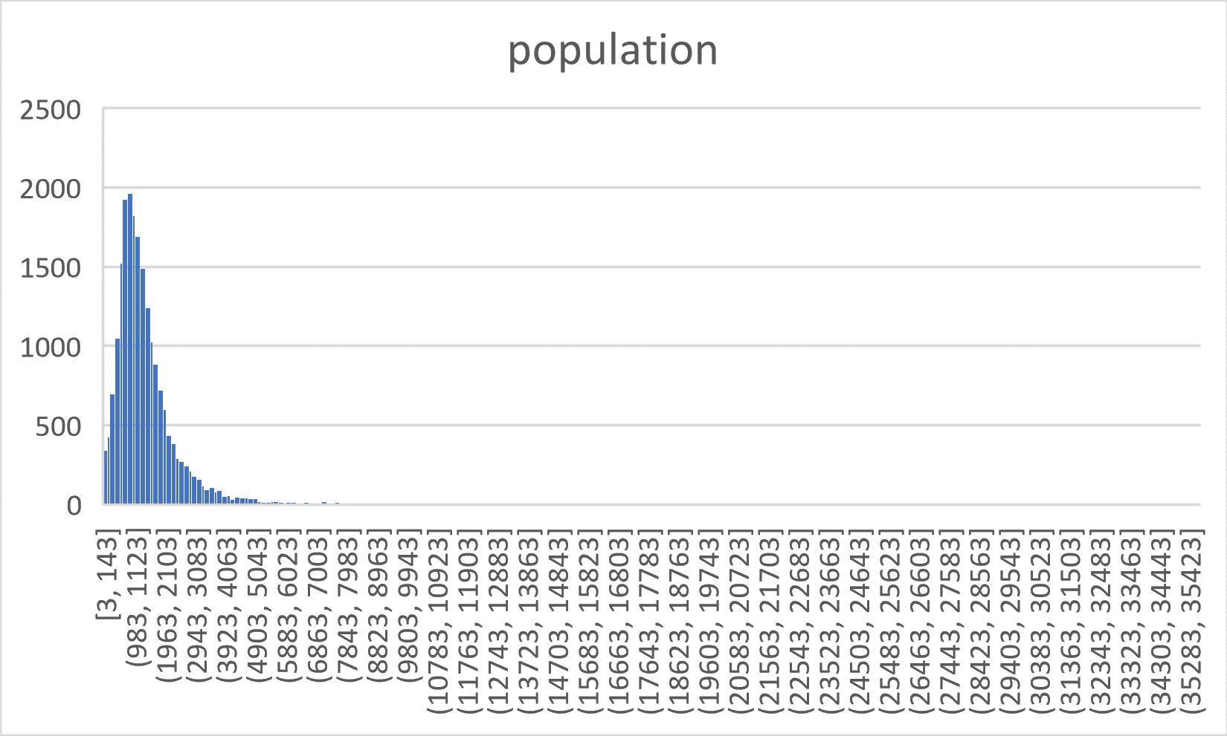
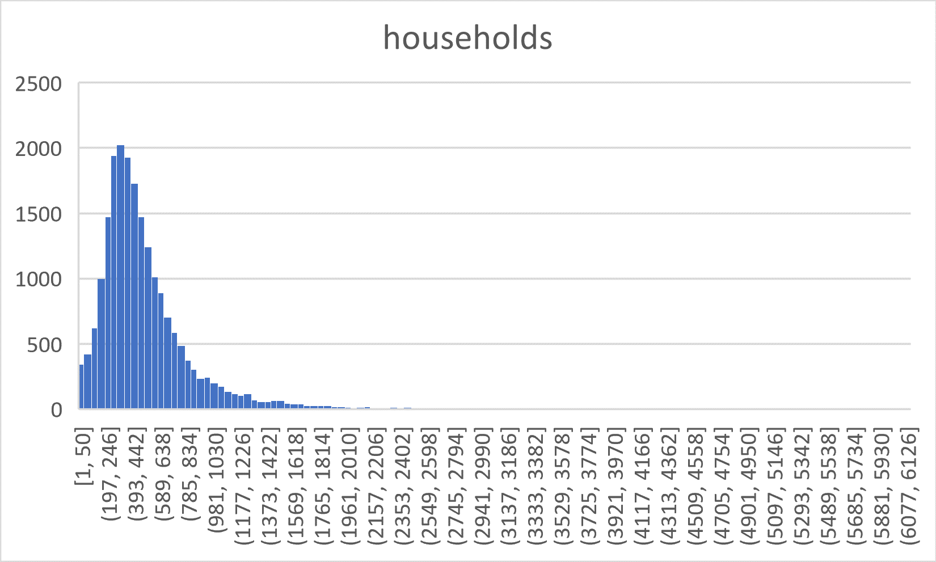
Descriptive Analysis
The distributions are normal but skewed to the right

Slide 7
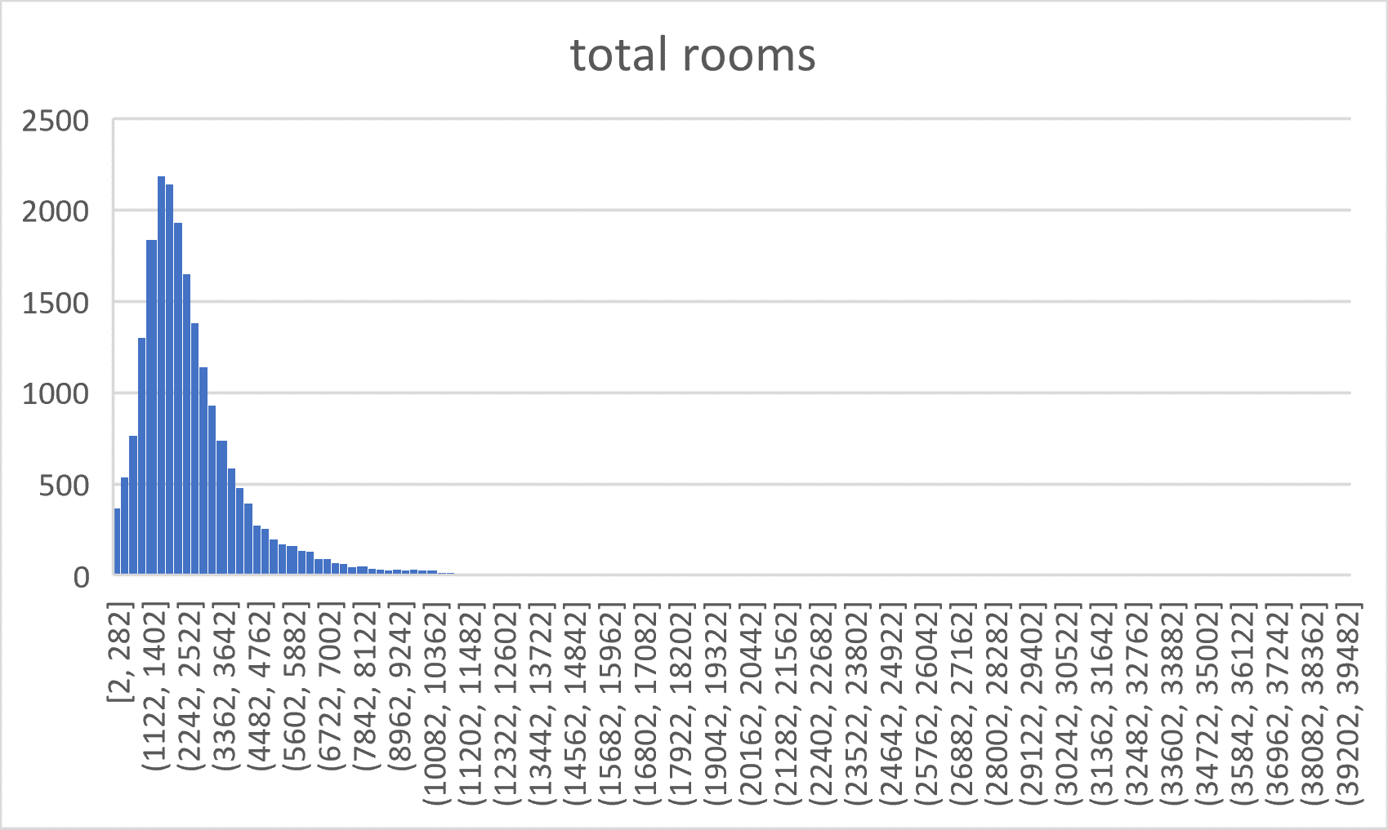
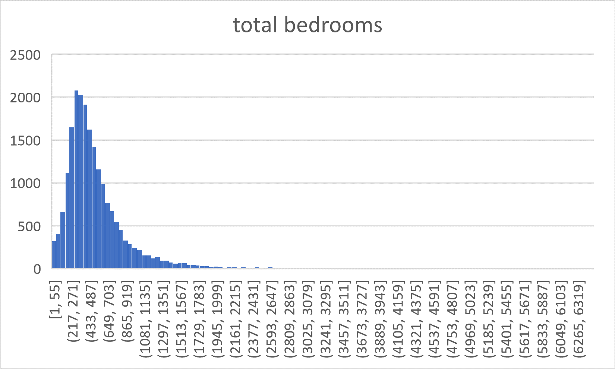
Descriptive Analysis
The distributions are normal but skewed to the right

Slide 8
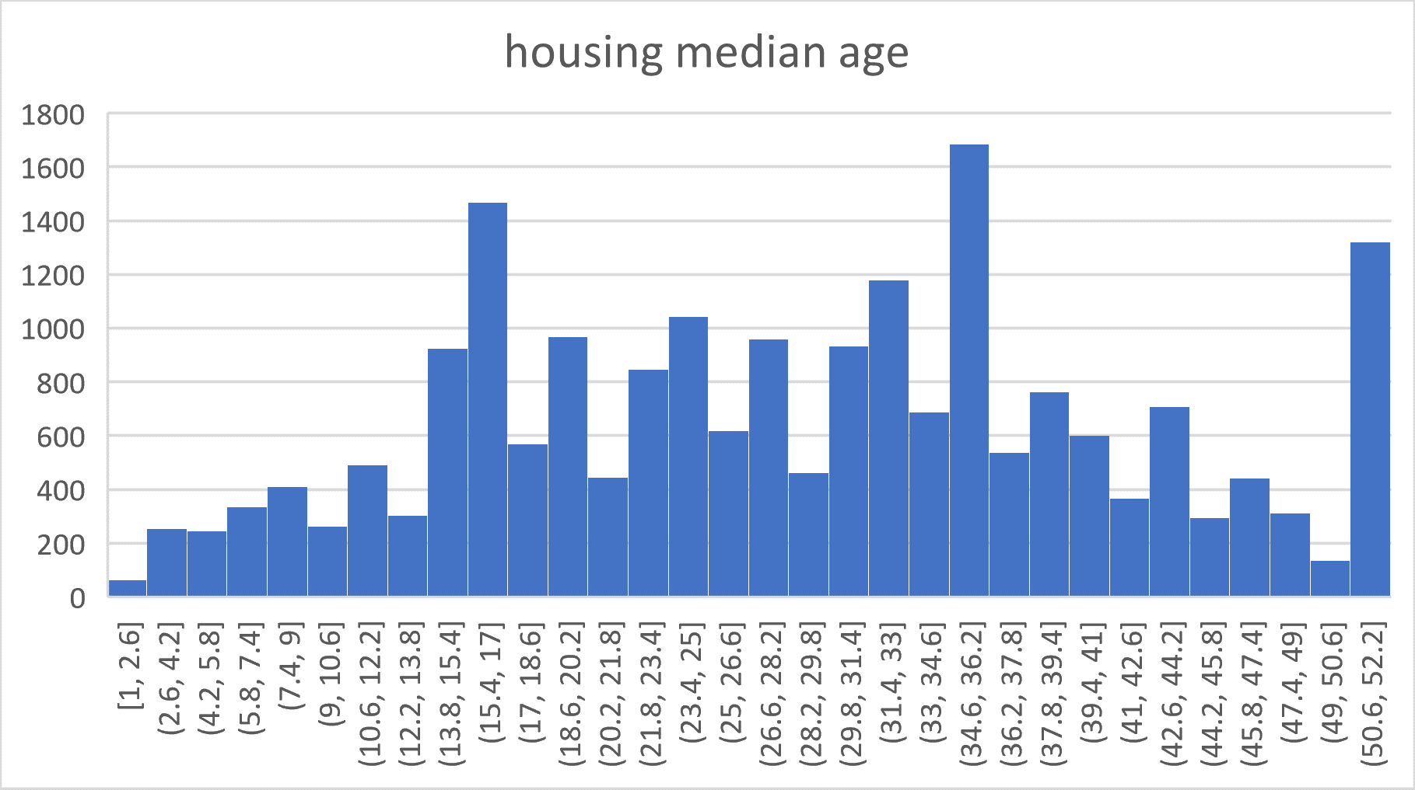
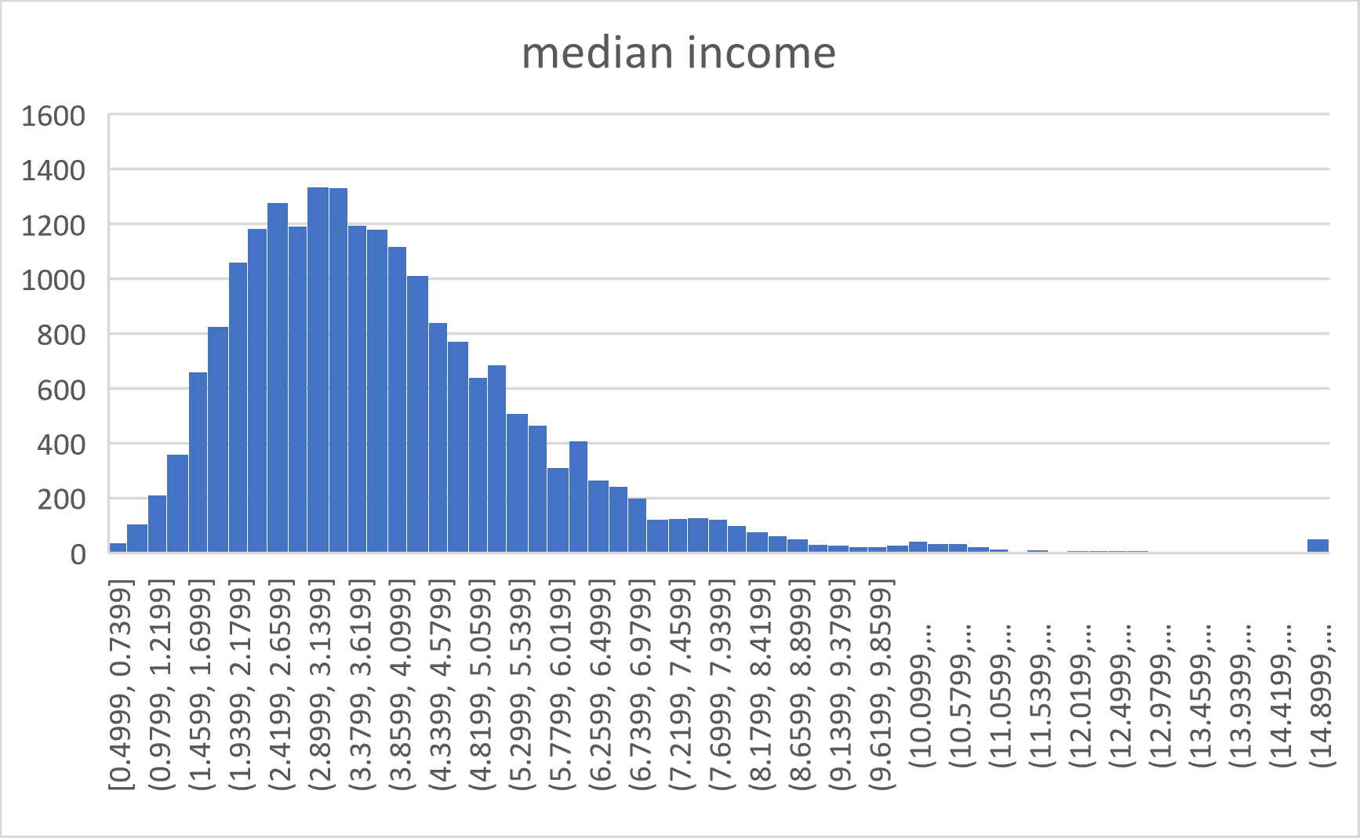
Descriptive Analysis
The housing median age distribute is not normal.
The median income distribution is normal

Slide 9
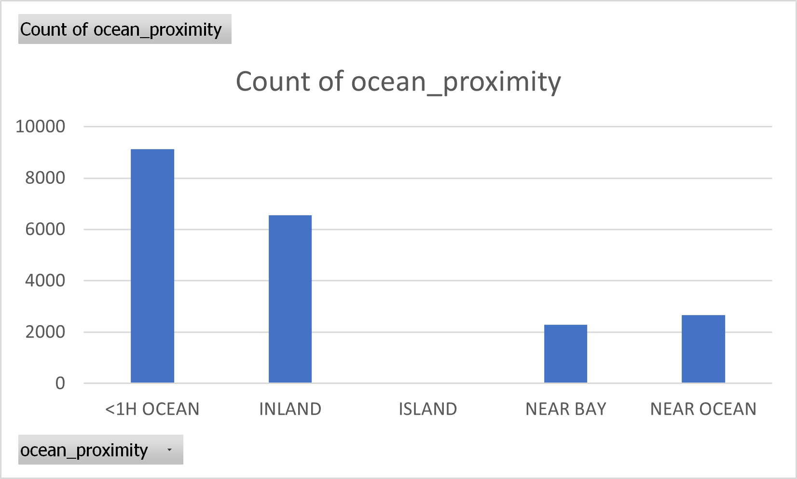
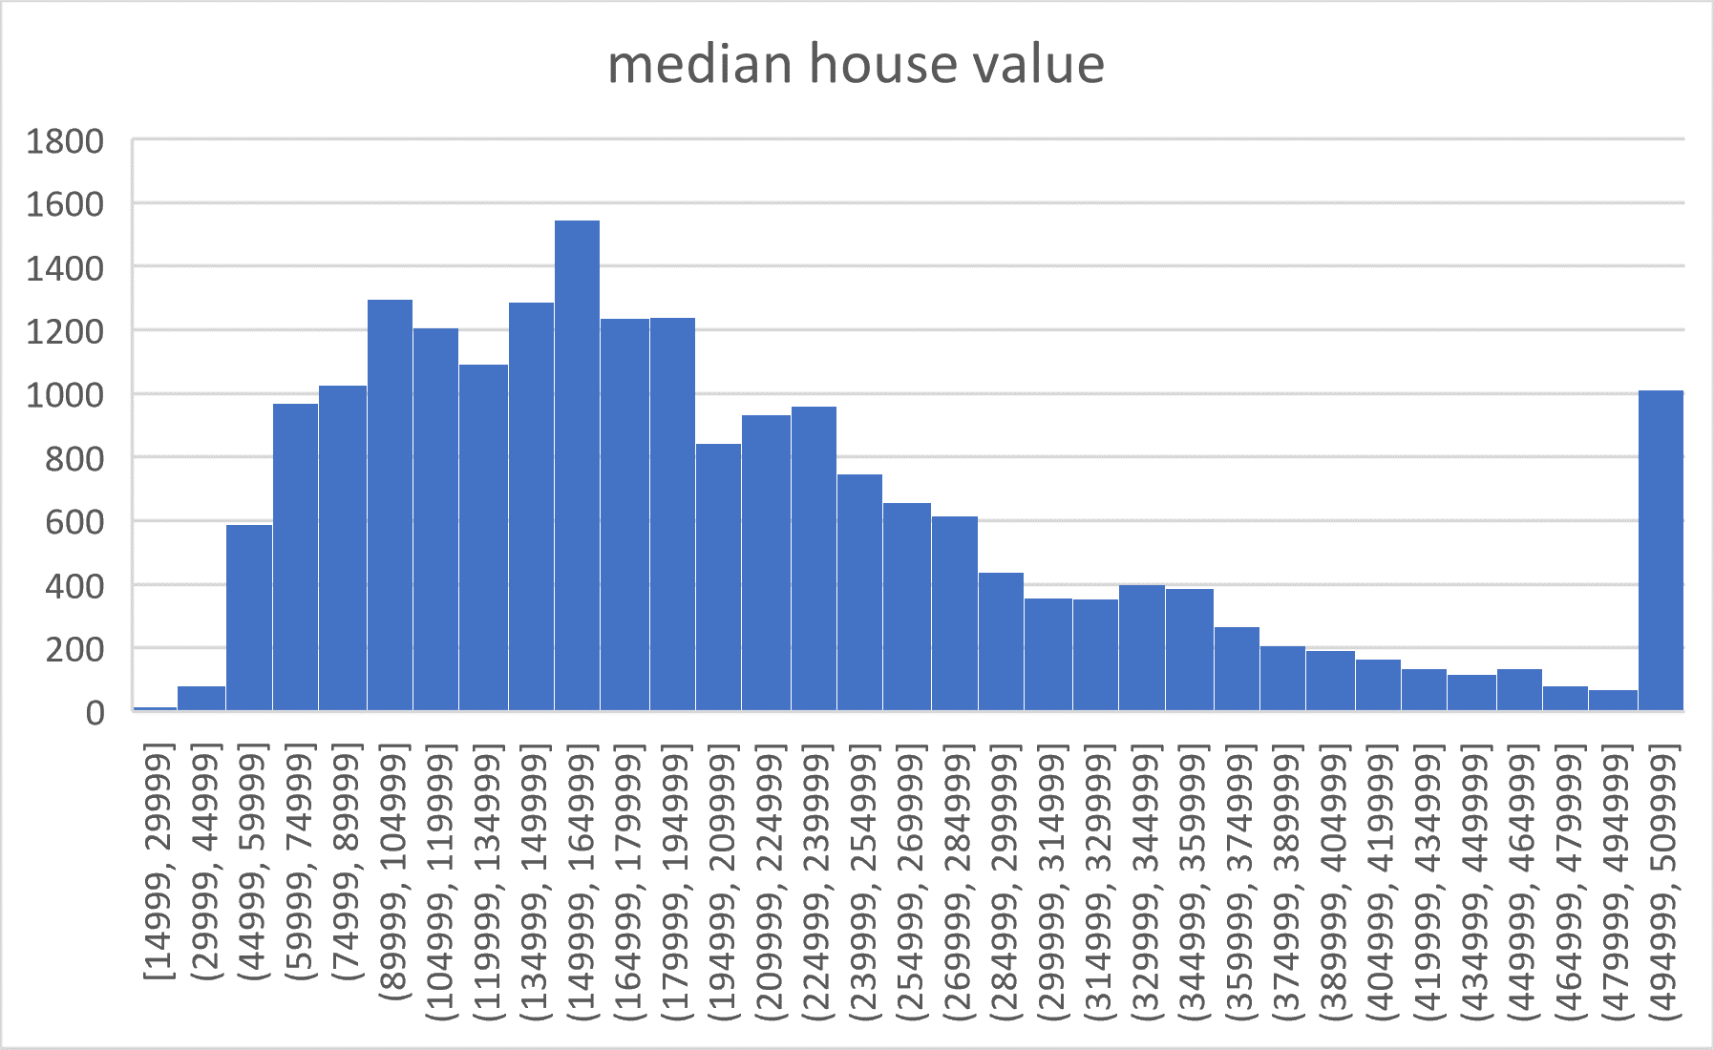
Descriptive Analysis
Majority of districts are either 1 hour from ocean or inland.
Median house value is normal except the peak in the far right.

Slide 10
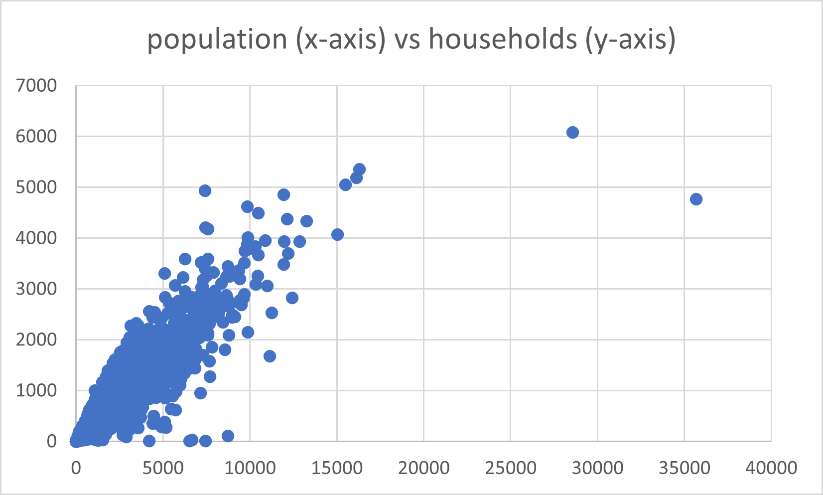
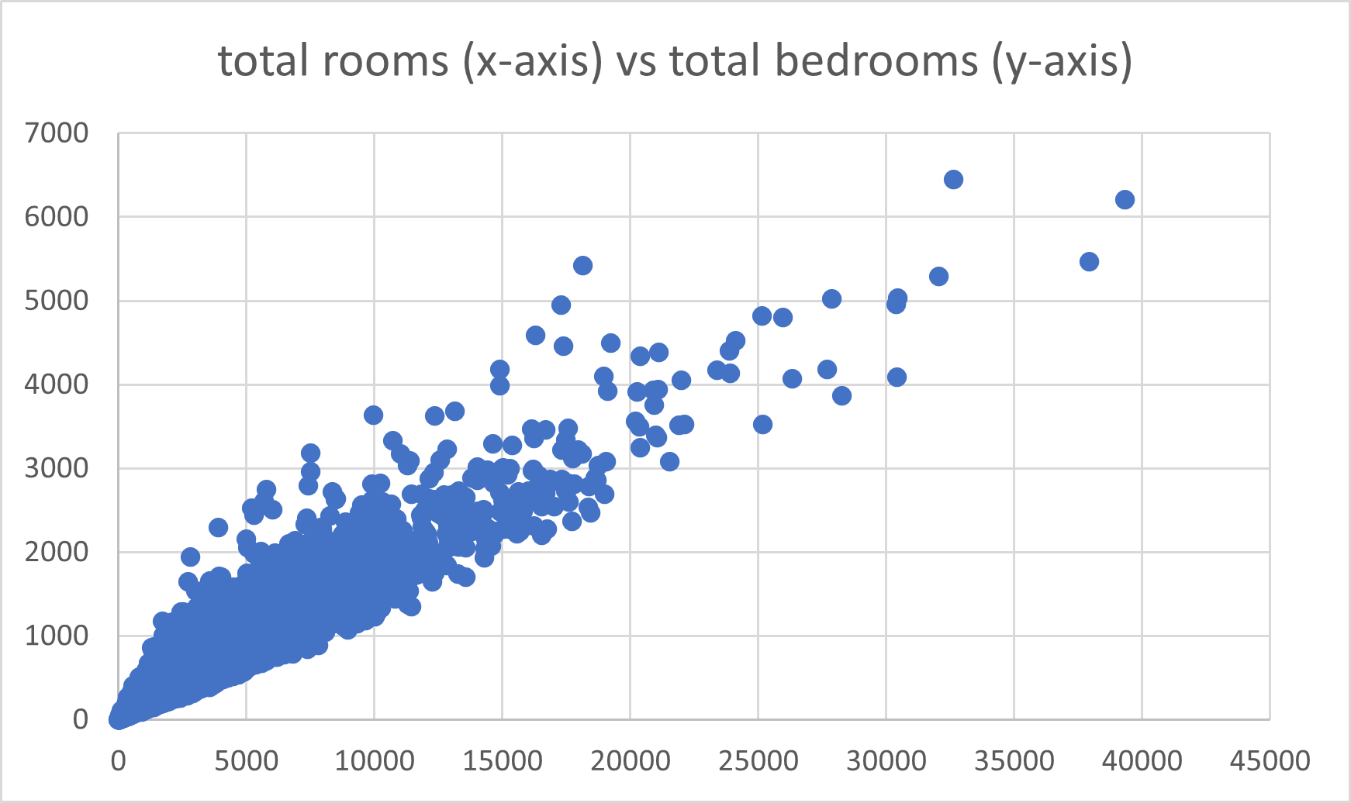
Descriptive Analysis
population and households have positive linear correlation
total rooms and bedrooms have positive linear correlation.

Slide 11
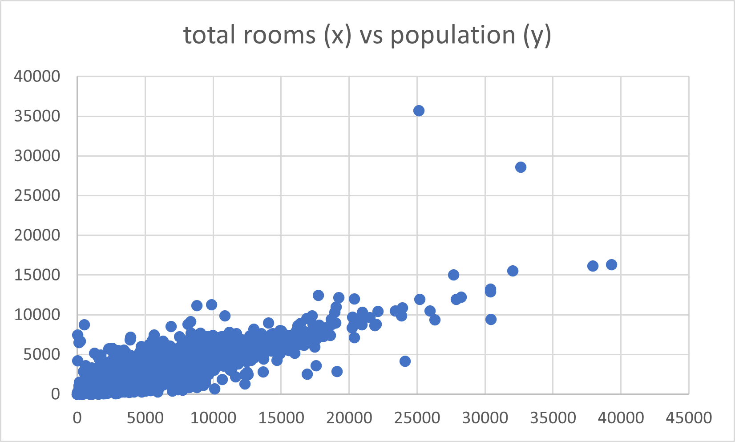
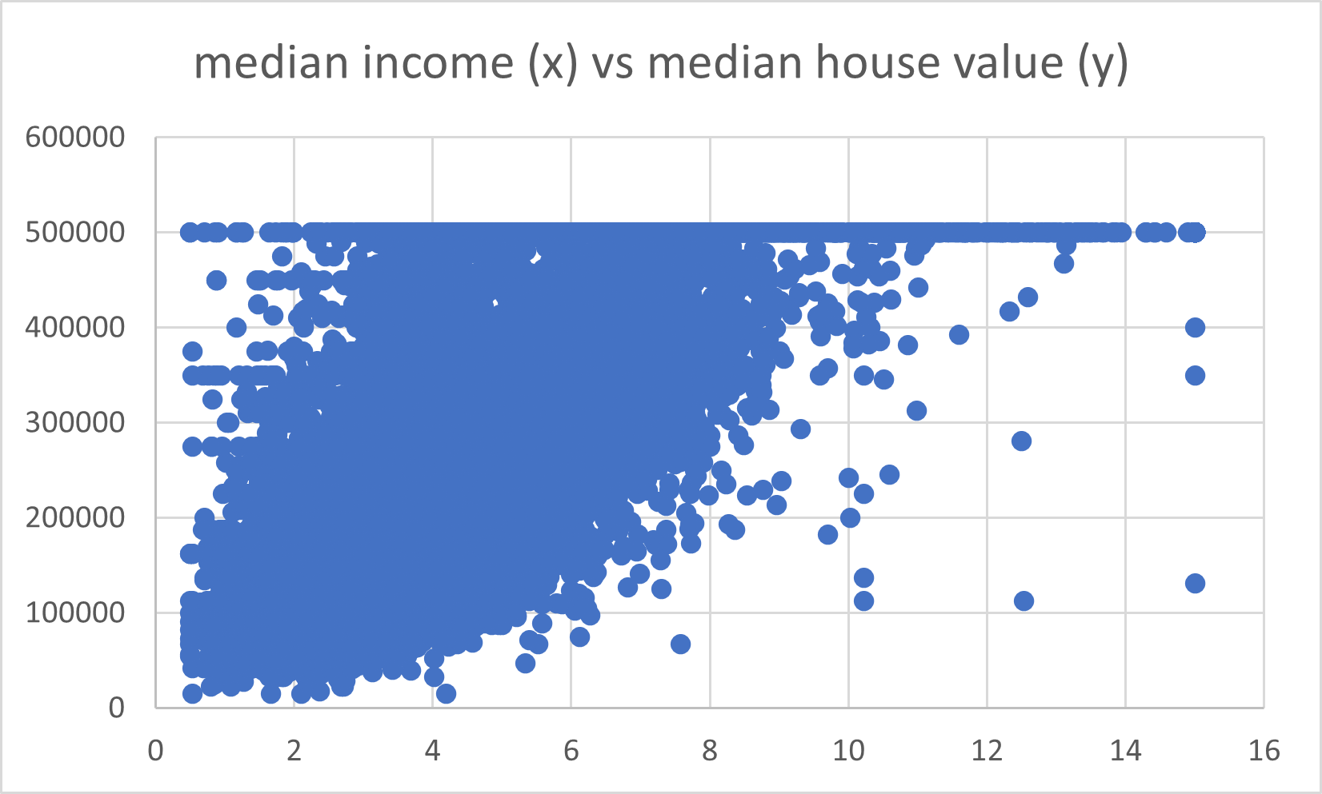
Descriptive Analysis
total rooms and population have positive linear correlation.
median income and median house value have positive correlation.
median house value seems to be artificially capped at 500,000

Slide 12
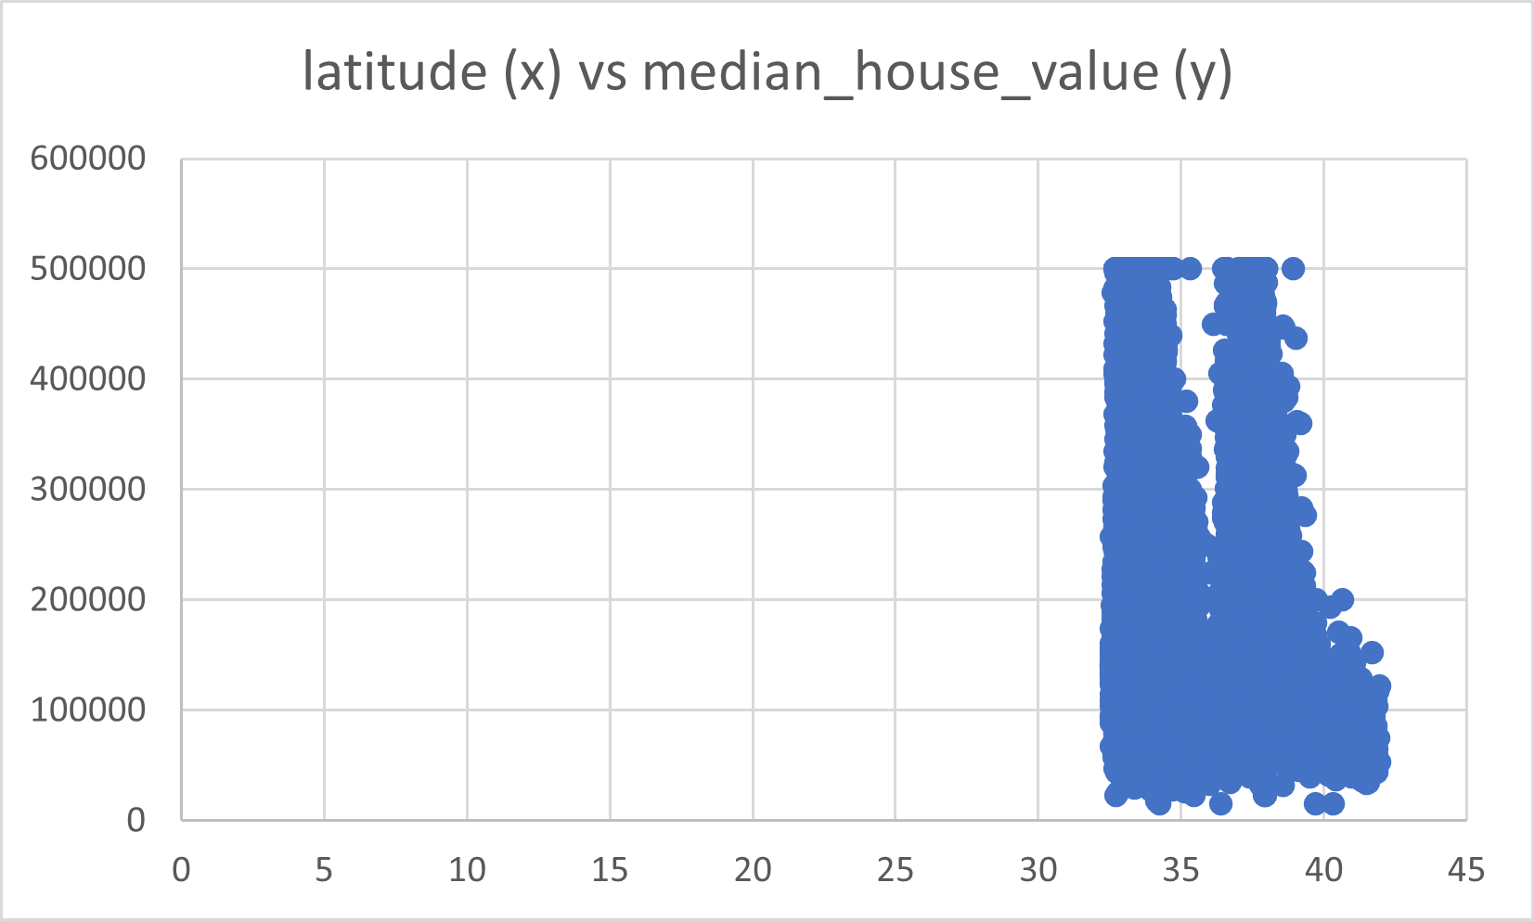
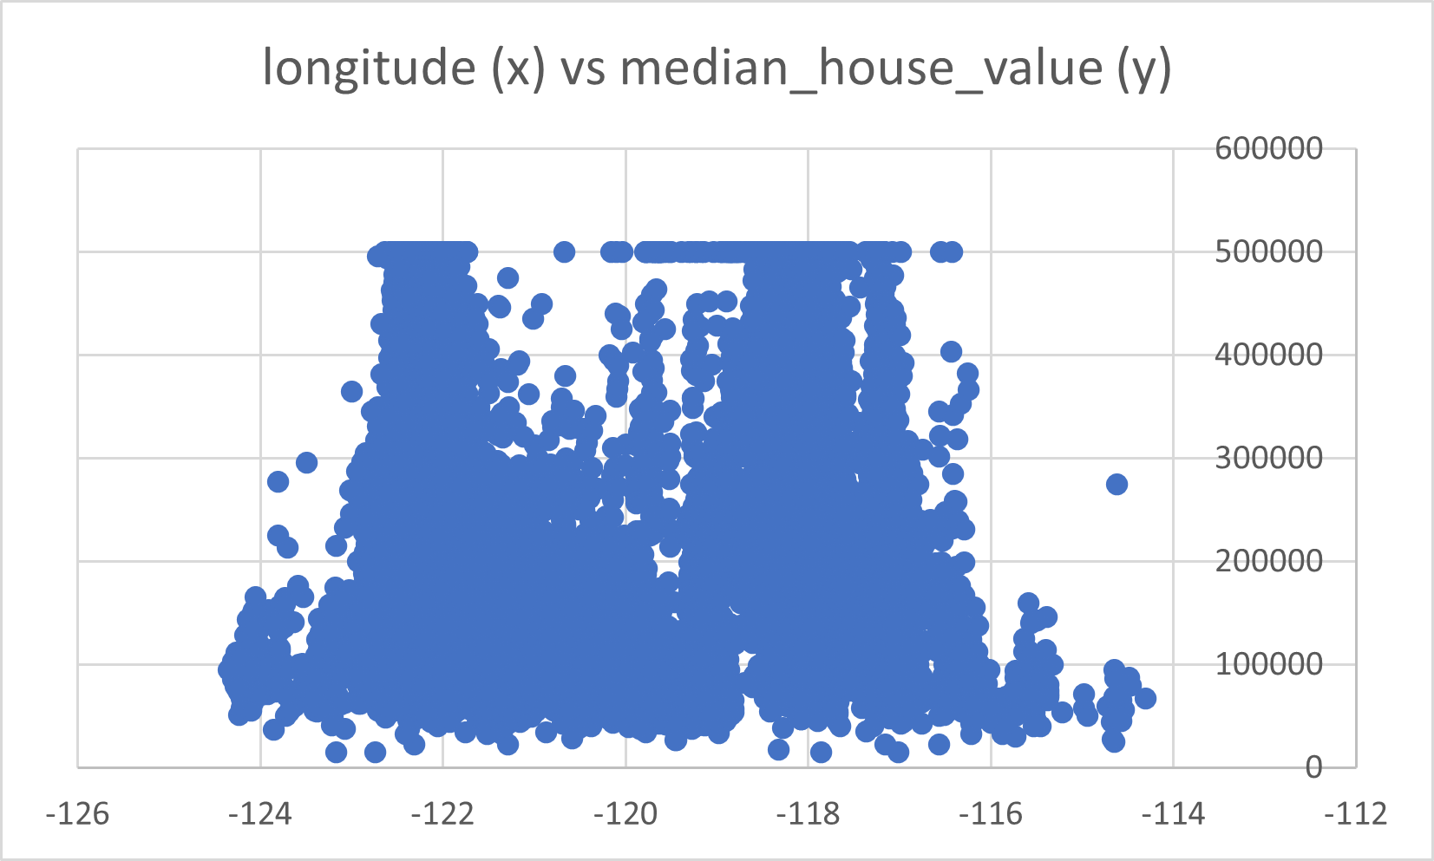
Descriptive Analysis
It seems that latitude and longitude have no correlation with median_house_value

Slide 13
Correlation Matrix
 | longitude | latitude | housing_median_age | total_rooms | total_bedrooms | population | households | median_income | median_house_value
longitude | 1 | -0.92 | -0.10 | 0.00 | 0.04 | 0.10 | 0.03 | -0.02 | -0.05
latitude |  | 1 | 0.00 | 0.00 | -0.05 | -0.12 | -0.06 | -0.08 | -0.14
housing_median_age |  |  | 1 | -0.34 | -0.28 | -0.26 | -0.26 | -0.13 | 0.11
total_rooms |  |  |  | 1 | 0.90 | 0.79 | 0.89 | 0.25 | 0.17
total_bedrooms |  |  |  |  | 1 | 0.84 | 0.97 | -0.01 | 0.07
population |  |  |  |  |  | 1 | 0.87 | 0.00 | -0.03
households |  |  |  |  |  |  | 1 | 0.01 | 0.09
median_income |  |  |  |  |  |  |  | 1 | 0.65
median_house_value |  |  |  |  |  |  |  |  | 1

Slide 14

Data Analysis
Linear Regression regularization terms
ElasticNetParam corresponds to α
regParam corresponds to λ

Slide 15
Model 1: Use all 12 Features
Linear Regression
features = 12, regParam=0.01, elasticNetParam=1.00
r2 = 0.63, rootMeanSquareError = 67,548, meanAbsoluteError = 49,389
 | median_house_value | Prediction
1 | 94,600 | 214,520
2 | 85,800 | 133,393
3 | 103,600 | 174,331
4 | 111,400 | 197,642
5 | 78,300 | 149,474

Slide 16
Model 2: Use all 12 features
Gradient Boosted Trees Regression
features = 12, minInstancesPerNode=10, minInfoGain=0.1
r2 = 0.75, rootMeanSquareError = 55,085
 | median_house_value | prediction
1 | 94,600 | 102,221
2 | 85,800 | 98,334
3 | 103,600 | 118,546
4 | 111,400 | 87,536
5 | 78,300 | 118,993

Slide 17
Tune Hyperparameters: Search for top features
Linear Regression
regParam=0.01, elasticNetParam=1.00
featureType = continuous, labelType = continuous for Univariate Feature Selectors to use F-value selector

Slide 18
Tune Hyperparameters: Search for Top Features
numTopFeatures | r2 | rootMeanSquaredError
12 | 0.63 | 67,548
10 | 0.59 | 70,673
9 | 0.59 | 70,812
8 | 0.59 | 71,112
7 | 0.59 | 71,047
6 | 0.53 | 75,317
top 7 features: latitude, housing_median_age, total_rooms, total_bedrooms, households, median_income, ocean_proximity_INLAND

Slide 19
Model 3: Use Top 7 Features
Linear Regression.
regParam=0.01, elasticNetParam=1.00, featureType = continuous, labelType = continuous
numTopFeatures = 7, r2 = 0.59, rootMeanSquareError = 71,047
 | median_house_value | prediction
1 | 94,600 | 207,162
2 | 85,800 | 135,651
3 | 103,600 | 179,598
4 | 111,400 | 181,010
5 | 78,300 | 148,531

Slide 20
Model 4: Tune regParam and elasticNetParam
Linear Regression. Grid Search for regParam and elasticNetParam
features = 12
best params: regParam= 1.0, elasticNetParam= 0.0,
r2 = 0.64, rootMeanSquareError = 66,626
 | median_house_value | prediction
1 | 94,600 | 202,828
2 | 85,800 | 101,478
3 | 103,600 | 143,518
4 | 111,400 | 181,108
5 | 78,300 | 120,018

Slide 21
Model 5: Tune regParam and elasticNetParam
Linear Regression. Grid Search for regParam and elasticNetParam
features = 7
best params: regParam= 1.0, elasticNetParam= 0.0,
r2 = 0.59, rootMeanSquareError = 70,639
 | median_house_value | prediction
1 | 94,600 | 210,480
2 | 85,800 | 133,839
3 | 103,600 | 180,432
4 | 111,400 | 181,246
5 | 78,300 | 145,625

Slide 22
Model 6: Use Top 7 Features
Gradient Boosted Trees Regression
minInstancesPerNode=10, minInfoGain=0.1
features = 7
r2 = 0.67, rootMeansSquareError = 63,599
 | median_house_value | prediction
1 | 94,600 | 125,668
2 | 85,800 | 90,149
3 | 103,600 | 99,392
4 | 111,400 | 92,000
5 | 78,300 | 86,878

Slide 23
Model Comparison
Regression |  |  |  |  | Features | r2 | RMSE
Linear | regParam=0.01 | elasticNetParam=1.00 |  |  | 12 | 0.63 | 67,548
Linear: Tune Top Features | regParam=0.01 | elasticNetParam=1.00 | featureType = continuous | labelType = continuous | 7 | 0.59 | 71,047
Linear: Tune reg & elasticNet | regParam=1.0 | elasticNetParame=0 | featureType=continuous | labelType=continuous | 12 | 0.64 | 66,626
Linear: Tune reg & elaticNet | regParam=1.0 | elasticNetParam=0 | featureType = continuous | labelType = continuous | 7 | 0.59 | 70,639
Gradient Boosted Trees | minInstancesPerNode=10 | minInfoGain=0.1 |  |  | 12 | 0.75 | 55,085
Gradient Boosted Trees: Use Top Features | minInstancesPerNode=10 | minInfoGain=0.1 | featureType = continuous | labelType = continuous | 7 | 0.67 | 63,599

Slide 24
Summary of Findings
Gradient Boosted Trees Regression greatly improves the model
Changing regParam, elasticNetParam for Linear Regresson has little effect
Best model is given by Gradient Boosted Trees Regression using all 12 features

Slide 25
Implications
For real estate investors, able to predict housing price will help make informed decisions.
Models built by Gradient Booted Regression can be a valuable tool.
A better model is needed to accurately predict housing price .

